Slide 1
Coulomb excitation of ^{127,128}Cd
R. Krücken¹, M. Gorska², P. Boutachkov², A. Dewald⁵, R. Gernhäuser¹,
A. Jungclaus⁴, Th. Kröll³, D. Mücher¹, F. Naqvi², R. Orlandi⁴,
M. Pfuetzner⁶, M. Schlarb¹ et al.
¹TU München, ²GSI Darmstadt, ³TU Darmstadt,
⁴IEM-CSIC Madrid, ⁵IKP Köln, ⁶Warsaw University

Slide 2
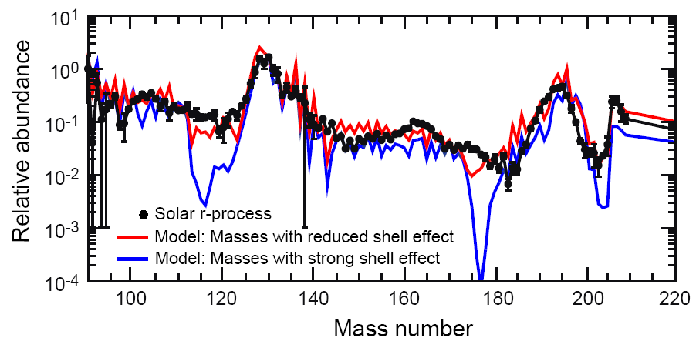
Shell quenching or not at N=82?
Langanke, K. & Martínez-Pinedo, G. Rev. Mod. Phys. 75, 819-862 (2003)
K. –L. Kratz, Astrophys. J. 403, 216 (1993).
B. Chen et al., Phys. Lett. B 355, 37 (1995).
B. Pfeiffer, K. –L. Kratz and F. –K. Thielemann, Z. Phys. A 357, 235 (1997).
¹³⁰Cd scrutinized: ➔ no shell quenching
A. Jungclaus et al., PRL 99, 132501 (2007)
I. Dillmann et al., Phys. Rev. Lett. 91, 16 (2003).
T. Kautzch et al., Eur. Phys. J A 9, 201 (2000).
M. Hannawald et al., Phys. Rev. C 62, 054301 (2000).

Slide 3
Energies and B(E2) values
unusually low 2⁺ energy of ¹²⁸Cd
➔ Enhanced collectivity?

Slide 4
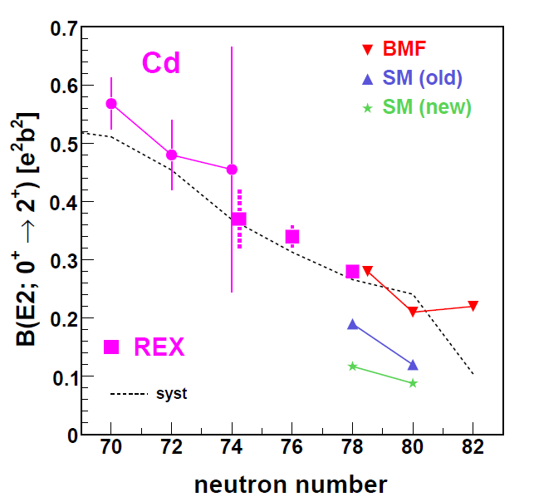
Predicted B(E2) values
low B(E2) values predicted by SM, higher values for Beyond Mean Field
Resolve via Coulomb excitation!!
A. Jungclaus et al., Act. Phys. Pol. B 40, 427 (2009).
T.R. Rodriguez et al. Phys. Lett. B 668 (2008) 410

Slide 5
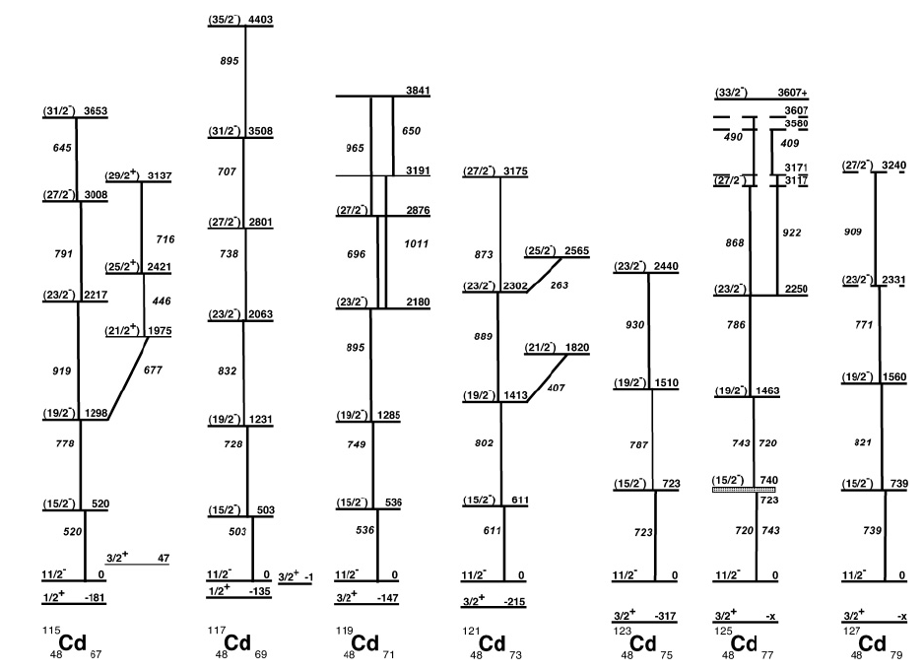
Evolution of the 11/2- structure in odd Cd
Non-axial deformed
spherical, vibrational
N. Fotiades et al., Phys. Rev. C 61, 064326 (2000)
νh11/2 structure evolves from deformed at mid-shell to vibrational near N=82
3/2+ states similar to even-even Cd ground states?
R=2,1
R=2,1
R=2,5
R=2,4
R=2,3
R=2,3
N. Hoteling et al., Phys. Rev. C 76, 044324 (2007).

Slide 6
127Cd
739 keV
822 keV
Not 19/2- as before!
Transition order could be resolved via Coulomb excitation!!
Case -I
Case -II
Transition | σL | B(σL) (W.u)
 |  | SM | Case-I | Case-II
19/2⁺ 13/2⁻ | E3 | 3.82 X 10⁻² | 2.30(30) X 10⁻¹ | 3.40(18) X 10⁻²
19/2⁺ 15/2⁻ | M2 | 5.78 X 10⁻³ | 7.71(16) X 10⁻⁵ | 2.71(14) X 10⁻⁴
F. Naqvi et al., in preparation.

Slide 7
Feasibility
¹²⁸Cd production rate :
650 AMeV 235U beam (2x10⁹ pps), 1 g/cm² Be
Production cross section: 15 microbarn
Rate estimates (LISE):
➔ S4 rate: 36 pps with 137 AMeV (total rates S2: 5000 pps, S4: 200 pps)
Coulomb excitation cross-section: 200 mb (0.1 e²b²)
400 mg/cm² Pb target
AGATA photo peak efficiency of 0.175
➔ 145 particle-gamma coincidences per day for ¹²⁸Cd ➔ 5 days

Slide 8
Summary
Relativistic Coulomb excitation on ^{127,128}Cd
Help resolve the intriguing structure of Cd isotopes near N=82 (spherical vs. collective)
¹²⁸Cd:
B(E2) value to distinguish between BMF and SM predictions
¹²⁷Cd:
resolve observed excitation structure built on 11/2- state
B(E2) value provides information on single-particle vs. collective structure
Observation of excitations of 3/2+ ground state (how to firmly establish this transition?)
Possibly excitation of 17 mus isomer observable (needs isomer tagging at LYCCA)
Needs 5 days of main beam time + 2 days calibration run on ¹²⁶Cd
May run using same set-up as Cd plunger experiment (without degrader)

Slide 9
Shell Model Calculations
EXP
SM
H. Grawe et al.
F. Naqvi et al., in preparation.
L. Cáceres et al., PRC. 79, 011301 (2009)

Slide 10
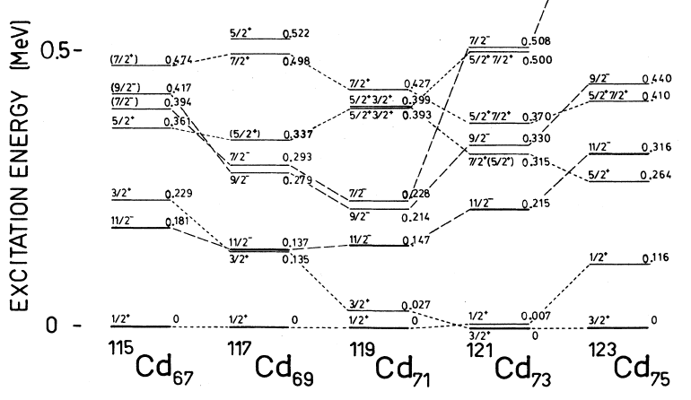
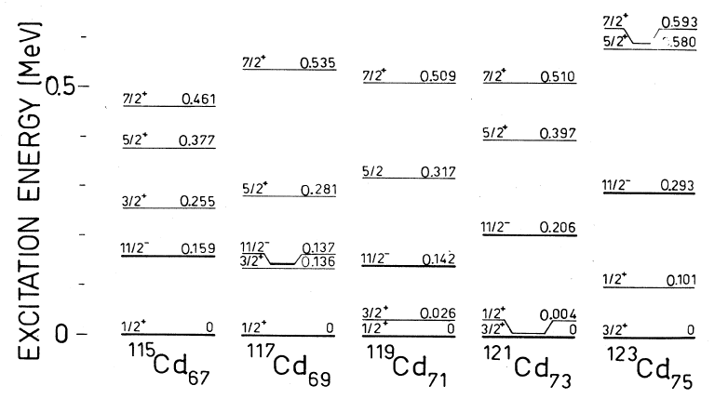
BCS plus proton-neutron interaction
H. Huck et al., PRC40 (1989)1384

